Slide 1
PTE BH Objectives
To understand Pathways to Excellence process for physician practices
Explore how to utilize PTE process for Behavioral Health

Slide 2
Experience with Health Data: It is both less and more complicated than what people say.
Maine Health Data Organization Board, 1997 to 2002, 2009 - 2013.
Maine Health Information Center/Onpoint Board, 2003- 2010
Maine Data Processing Board 2007-08
AHRQ Healthcare Cost and Utilization Project Steering Committee, 2010- 2012
NCQA Committee on Performance Measurement, 2009 - 2011
National-Regional Workgroup of the Quality Alliance Steering Committee, 2008 - present
National Quality Forum: Workgroup on Patient Reported Outcomes Measures, 2012-13

Slide 3
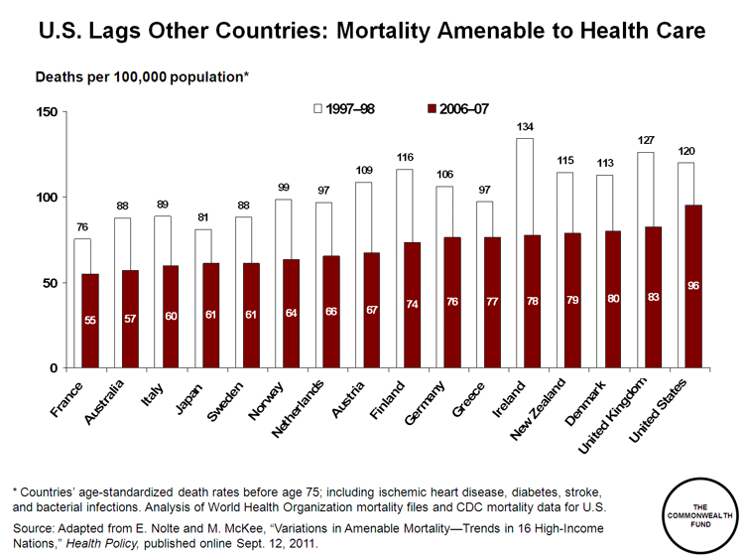
Our Quality Is Less………
BETTER
3

Slide 4
Our Costs Are More
International Comparison of Spending on Health, 1980–2010
Average spending on health
per capita ($US PPP)
Total health expenditures as
percent of GDP
Notes: PPP = purchasing power parity; GDP = gross domestic product.
Source: Commonwealth Fund, based on OECD Health Data 2012.

Slide 5
Problems with UnderUse
2004: Adults receive about half of recommended care
  54.9% = Overall care
  54.9% = Preventive care
  53.5% = Acute care
  56.1% = Chronic care
Not Getting the Right Care at the Right Time
Source: McGlynn EA, et al., “The Quality of Health Care Delivered to Adults in the United States,” New England Journal of Medicine, Vol. 348, No. 26, June 26, 2003, pp. 2635-2645

Slide 6
MHMC 1995
quality / outcomes +
Value: change in health status +
  employee satisfaction
  Cost
Best quality health care - B
Best outcomes and quality of life - D
Most satisfaction - B
For the most affordable cost – D- soon to be B+
For all Maine citizens - A

Slide 7
All Started With Depression - 1998
Employers saw depression crop up in all benefit programs (WC, GH, STD, LTD, Abs)
Ran EAP programs, but needed health system
1999-2000 MHIC Led Nurse Telecare initiative with 14 PCP practices
Improvement in med adherence, Hamilton Scores, SF-12 scores, and Household, Work, & Leisure Time Functioning
Productivity went up (but no one knew it), practices lost money (no one paid them), and drug costs increased

Slide 8
What To Do?
Employers couldn’t just focus on one disease
Seemed like chronic illness went together
Started initiative focused on depression, diabetes, CVD, & asthma
“Informing Patients & Rewarding Providers”

Slide 9
3 Basic Aspects of Quality
Type of Measure | Definition | Examples
Structure | The opportunity exists to obtain good care. | Right number / mix of providers. (e.g. PCP, specialists, MSW, etc.) Computerized Rx physician order entry
Process Interpersonal | Interventions are humane and responsive to patients’ preferences | Testing/treatment choices explained Patients get questions answered
Process Technical | Interventions are provided skillfully to the people who need them | Evidence-based guideline compliant treatment Right tests Right Rx, treatments etc.
Outcomes: clinical, functional, financial | The best possible clinical and patient results are achieved. | Normal lab values Patients live Symptom free days Patients function more effectively at work, home, and play

Slide 10
3 Basic Aspects of Quality –
Rooney’s view using CPDP Criteria
Type of Measure | PCPs | Specialties | Hospitals | ACOs
Structure | Good | Good | Good | Good
Process Interpersonal | Coming 50% | Coming 25% | Good | Good
Process Technical | Good for most processes | Poor except Cardiology | Good for most processes | Good
Outcomes: clinical | Good – 50% | Poor | Poor | Developing
Outcomes: Functional/Pop Hlth | Poor | Poor | Poor | Developing
Outcomes: financial | Total Cost of Care/Util. | Prometheus | Onpoint &/or Aetna | Total Cost of Care

Slide 11
PTE Evolution - Diabetes
2005: Practices measuring HbA1c, BP, LDL
2006: Practices with measures on 85% of patients with diabetes
2007: Achievement of certain outcomes of care

Slide 12
Pathways to Excellence – Physicians
Steering Committee 2014
Practice Leaders:
Jeff Aalberg, MD: MMC PHO
Bob Allen MD: PCHC
Michael Bergeron, MD: St. Mary’s
Frank Bragg, MD: EMMC
Tom Claffey, MD: InterMed
Ned Claxton, MD: CMMC
Barbara Crowley, MD: MaineGeneral
Marcus Deck, MD: Bowdoin Med Gp
Rich Engel, MD: Greater Portland MG
David Howes, MD: Martin’s Point
Lisa Letourneau, MD: Quality Counts
Jay Naliboff MD: Franklin
Gary Ross DO: MNH, Brewer
John Yindra MD: DFD, MCHO
Health Plans Med. Directors:
Aetna
Anthem
CIGNA
Harvard Pilgrim
MaineCare
Employers/Plan Sponsors:
Christine Burke: MEA Benefits Trust
Chris Brawn: State Employee Health Plan
Tom Hopkins: Univ. Maine System
Chris McCarthy: Bath Iron Works
Steve Gove: ME Municipal Health Trust
Joanne Abate: Hannaford Bros.

Slide 13
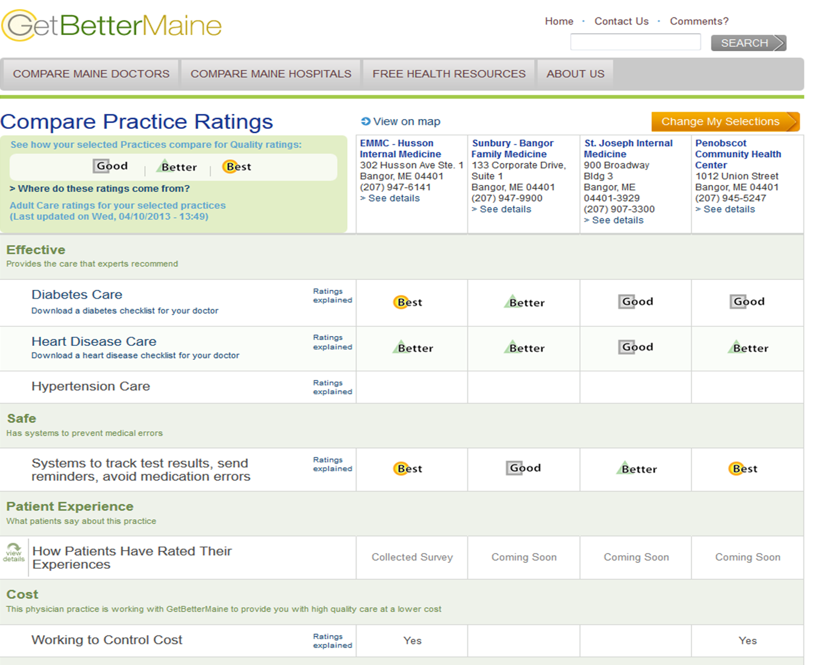
2013
Clinical Outcomes
Structure-Process
Interpersonal Process

Slide 14
MHMC 2004
Incent Patients and Providers
High
Effective & Inefficient
Effective & Efficient
Quality
Ineffective & Inefficient
Ineffective & Efficient
Low
High
Costs
Low
Efficiency w/o Quality is Unthinkable
Quality w/o Efficiency is Unsustainable

Slide 15
Health Plan - Employer Use
State of Maine Tiered Networks
  Hospital based on PTE Metrics 2006
    Waive $300 co-pay
  PCPs based on PTE 2-3 Blue Ribbons July 2007
    Waive $10 co-pay and deductible on office visits
  Deductible & co-pay waiver for diabetic pilot

Slide 16
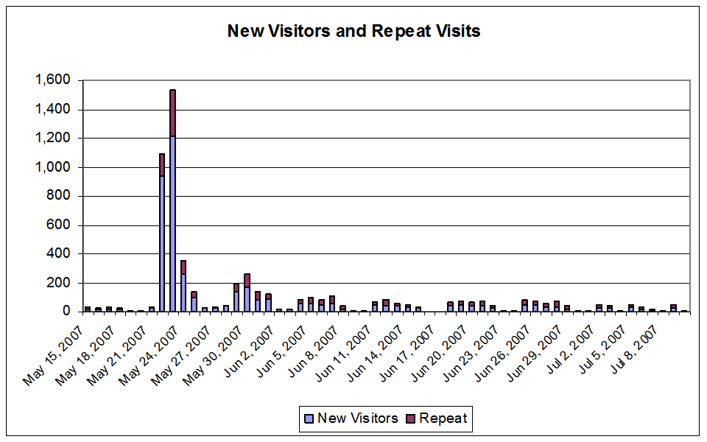
SEHC Announce 7-07 PCP Tiering

Slide 17
Current PTE Participation
Practices | 2007 | 2008 | % Ch
3 Blue Ribbon | 131 | 171 | + 31%
2 Blue Ribbon | 59 | 71 | + 20%
1 Blue Ribbon | 70 | 69 | -1%
0 Blue Ribbon | 169 | 125 | -26%

Slide 18

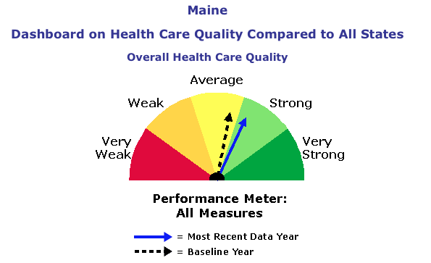
Maine: 2nd biggest improvement in US

Slide 21
State Employee June, 2008
My blood sugar numbers were in 400’s. Scary!
My A1C was 9.7, now it is below 7.5
What made me go:
1. Not having to pay co-pays on my medications for a year…That was incentive to get me in door
2. Even with $ incentive, I wouldn’t have kept coming back if the staff were punitive or judgmental, or had unreasonable expectations. Every staff person ….was helpful, understanding, and reasonable.

Slide 22
Aligning Maine’s“Forces”
QC/MHMC: AF4Q Consumer Messaging/ Leadership
Consumer Engagement
MHMC Employee Activation Program
MHMC : PTE reporting on hospitals, primary care, specialist quality
Perf Meas./ Public Report
MQF: reporting on hospital quality, patient experience of care (TBD)
Quality Improvement
MPIN, PHOs: QI support to mbr practices
Quality Counts: QC Learning Community
Benefit Design
MHMC: Encourage employer/payer use of PTE data for steering;
Value-based insurance design
Payment Reform
Hospitals/ Health Systems & Employers: Local ACO Pilots
Maine PCMH Pilot
Primary Care & Employers/Payers:
Alternative payment models
BIW Primary Care Program
Specialty Care:
Alternative payment models
Cognitive Consultation
Promote Health IT Adoption
MEREC: Promote primary care HER adoption, meaningful use
HealthInfoNet: Promote interoperable systems
Bangor Beacon: promote community-wide, connected HIT

Slide 23
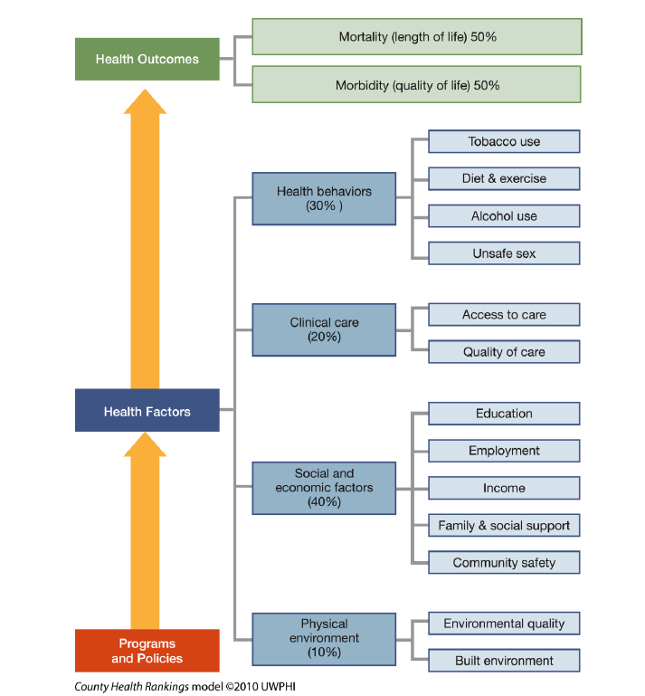
Univ. Wisconsin - RWJF County Health Rankings
What Contributes to Health Outcomes?
Employers & Consumers Get This – But What to Do?

Slide 24





Maine PCMH Pilot Community Care Teams
Environment
Schools
Transportation
Community Care Team
Housing
Outpatient Services
Workplace
Care Mgt
Family
Food Systems
High-need Individual
PCMH Practice
Med Mgt
Specialists
Community Resources
Shopping
Coaching
Hospital Services
Behav. Health & Sub Abuse
Income
Physical Therapy
Heat
Faith Community
Literacy

Slide 25
It’s About the Basics
(the hard work!)
Amb
Advanced Primary Care/PCMH (New workforce: Practice RN Care Managers)
Comm
Community Care Teams for High-Cost/High-Risk Patients (New workforce: CCT staff)
Comm
Enhanced Care Transitions (New workforce: Hospital + Community-based Care Transition Coaches)
Bundled Payments
Partial Capitation
Global Capitation
Healthcare Delivery System Change
Payment Reform
System Transformation

Slide 26
CMS ACO Metrics
Better Health for Individuals
CAHPS: 7 items
All cause readmission rate
Ambulatory sensitive conditions for COPD and CHF
% PCPs qualifying for EMR incentive
Medication Reconciliation after hosp.
Screening for fall risk

Slide 27
CMS ACO
Better Health for Populations
Preventive Health: 8 metrics including depression screen
Diabetes composite: 6 metrics
Hypertension
Heart Disease: 5 metrics

Slide 28
CMS ACO CAHPS
53. In the last 6 months, how often was it easy to get the care, tests or treatment you thought you needed?
57. In the last 6 months, did anyone on your health care team ask you if there was a period of time when you felt sad, empty, or depressed?

Slide 29
58. In the last 6 months, did you and anyone on your health care team talk about things in your life that worry you or cause you stress?
65. During the last 4 weeks, how much did your physical health interfere with your normal social activities with family, friends, neighbors or groups?

Slide 30
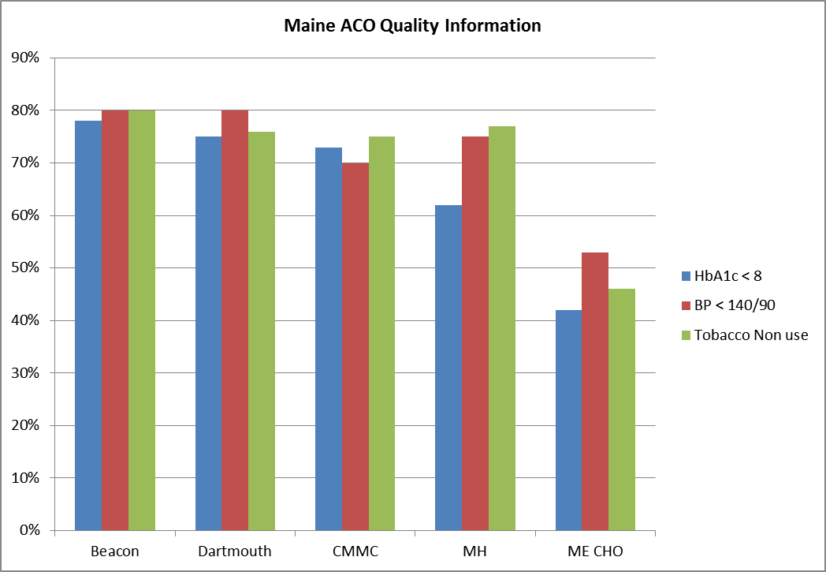
March 2014

Slide 31
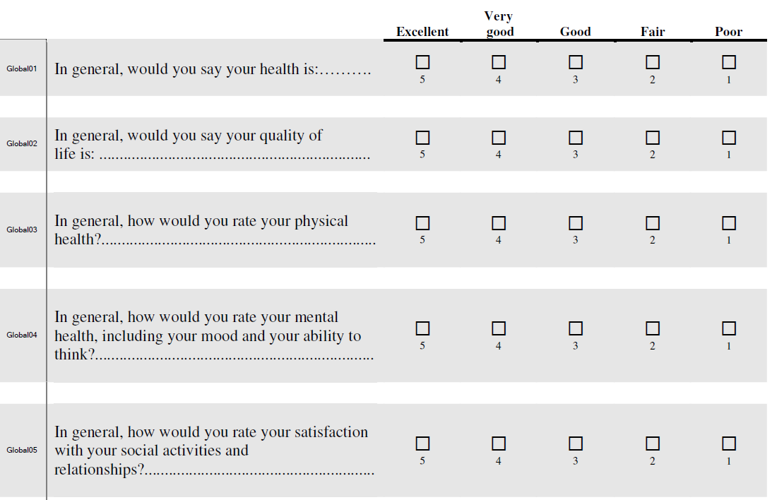
Promis

Slide 32
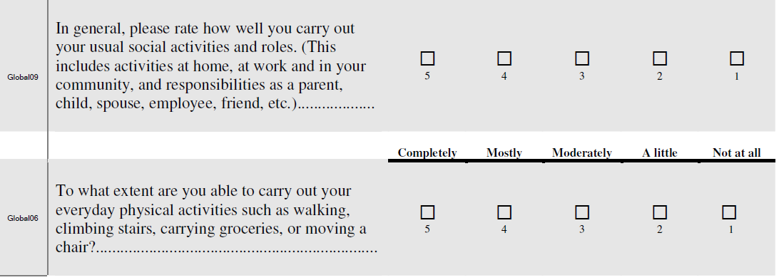
Focus On Behavioral Health

Slide 33
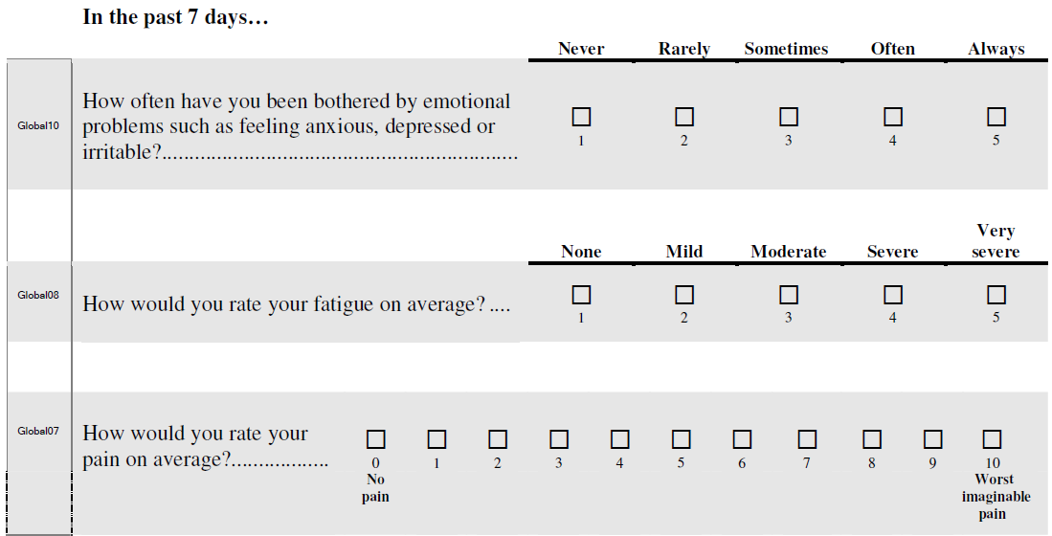

Slide 34
Head and Heart
Money
Recognition
Right Thing

